Slide 1











HOW TO SELL WITH
MAP & MATCH

Slide 2



BASIC PRINCIPLES
Customers don't buy a tool, they buy your support
The tool is only there to make you more efficient in meeting your customer's needs.
Ex:
Working better with your team
Diagnose your organization
Enhance knowledge of the candidate in a recruitment context
Succession planning
Accelerate a new position
Make change management more effective

Slide 3

PITCH: PRESENTATION
Elevator pitch
map & match is a powerful booster of individual and collective performance, based on employees' skills and complementarity. Particularly useful in contexts .....
Différence
It's innovative because it relies on new soft skills based on the PLEASURE of employees in what they like to DO. There's nothing psychological, emotional or behavioral about this approach, it's about OPERATIONAL talents that reveal how a team will function, based on the energy of its members.
Unlike other solutions, map&match doesn't address the relationships that are created within a team, but rather the way it functions and what it needs to develop in relation to the objectives it has set itself. Just because a team gets along well doesn't necessarily mean it will win the match.

Slide 4
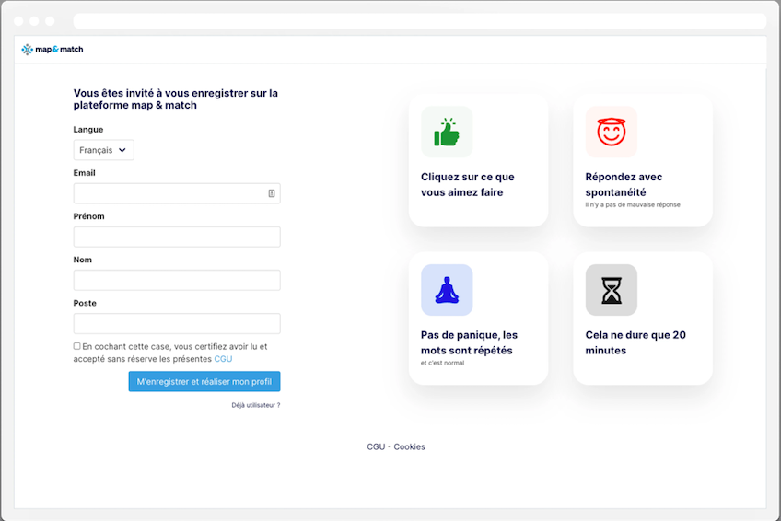
PITCH: PRESENTATION
Adapting the speech
Facing a manager/executive: the pitch will be built around individual and collective performance: "getting to know each other better to work better together and align on objectives".
Facing a HR manager: the pitch will be built around HR processes with contextualized illustrations (recruitment, integration, succession planning...).
How it works
An algorithm at the heart of a 15'/20' online questionnaire to reveal a person's profile in terms of what they like to do spontaneously, what they have developed and what takes up their energy. Complementary to technical skills.

Slide 5

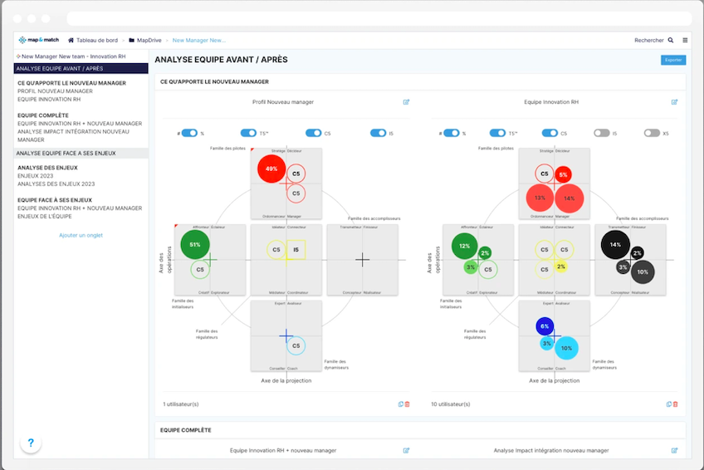
PITCH: PRESENTATION
A platform that makes it possible to :
Analyze an individual profile in terms of the dynamics expected of its role.
Consolidate this profile in a team to give the manager the keys that he/she will need to develop in his/her management.
Analyze the team's performance in relation to the dynamics required to achieve the objectives set. → optimize the complementarity of talents for greater performance.

Slide 6
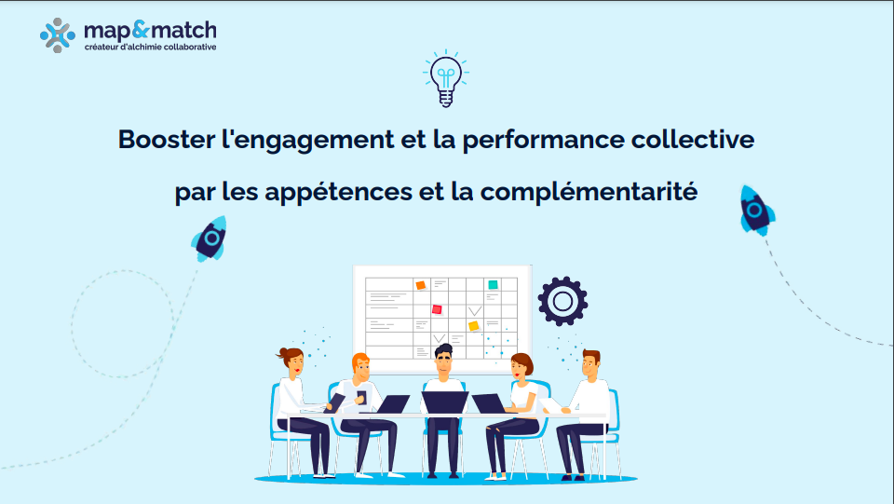

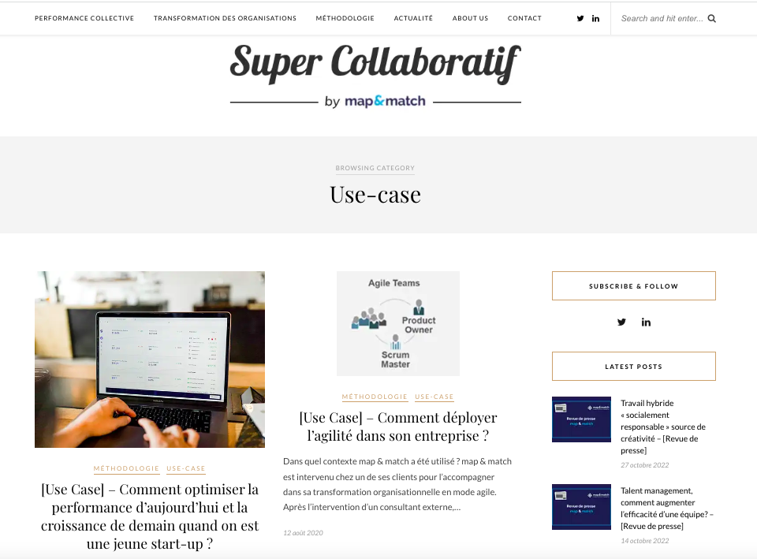
PITCH: PRÉSENTATION
Click here to see
Illustration.
Either short presentation (on map&match partners website)
or example of a CEO book with different profiles, the example of team analysis, of the manager facing his team, of binomials
Example of a recurring map&match customer:
BNP Leasing Solution et BNPPF, Comdata Groupe, Sonepar, Universal Music, Servier, Meridiam, Radio Télévision Suisse
Use case
Click here to see

Slide 7
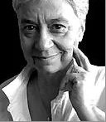
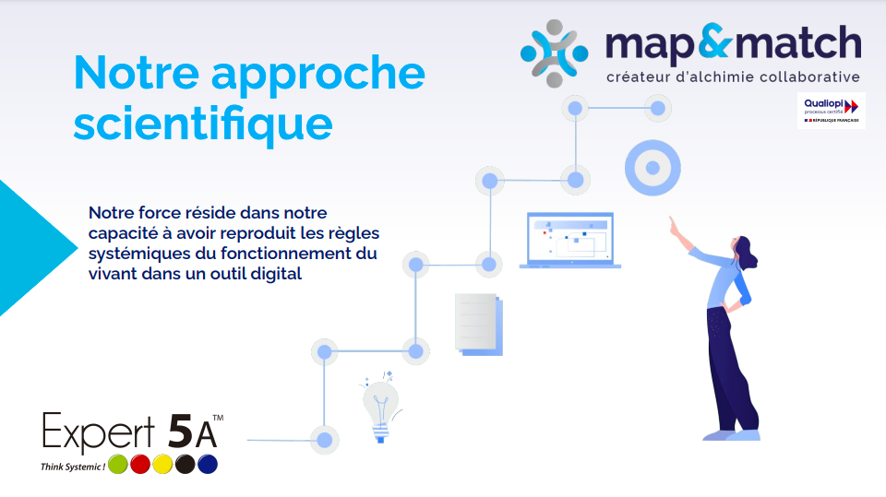
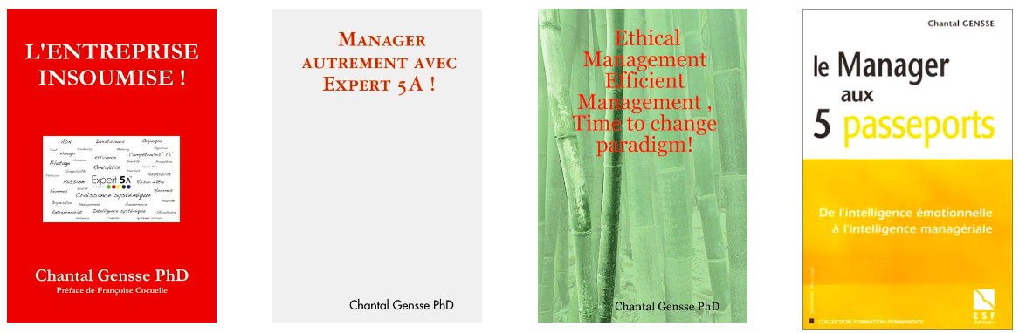
FOUNDATION/ANCHORING ELEMENTS
Research
20 years of research by Chantal Gensse Science by map&match (on partner site)
Engineer, 2 PhDs in France, 1 PhD in the US, certified in systems engineering.
She drew her inspiration from the functioning of living organisms to identify the optimal operating rules for a social system. A company, a team, a project.
Revealed new talents to activate each of the identified dynamics. e.g. analysis, decision-making, formalization, structuring, management, transmission, expertise, etc....
Published his first book in 2003 with Eyrolles Le manager aux 5 passeports, which won the 2004 manpower management book award.
Click here to see

Slide 8
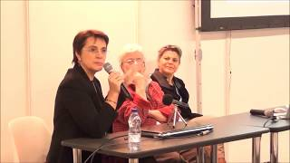
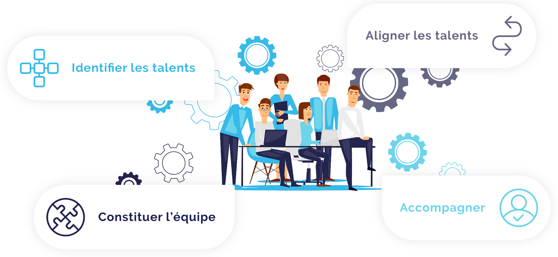
FOUNDATION/ANCHORING ELEMENTS
Application that validates the model and talents
In the 2000s, the foundations of map&match were applied to top-level athletes (2002, Jean Pierre Vidal, François Gabart, and later Amélie Mauresmo),
Since 2010, we've been advising executives and managers in their search for performance or transformation.
The start of map&match:
At the end of 2015, V1 of the platform was released in 2016, based on the Sanofi Group's project to transform its HR function in France: Sanofi - Testimony of Marie-Pascale Colombier
The test:
Three years of R&D between Chantal and her team, plus a testing specialist. To define the test modality that enables us to identify without bias (i.e. without projecting what we know how to do or think we should do) what we like or dislike doing. The choice made allows 226 dilemmas to pass to the right hemisphere.

Slide 9
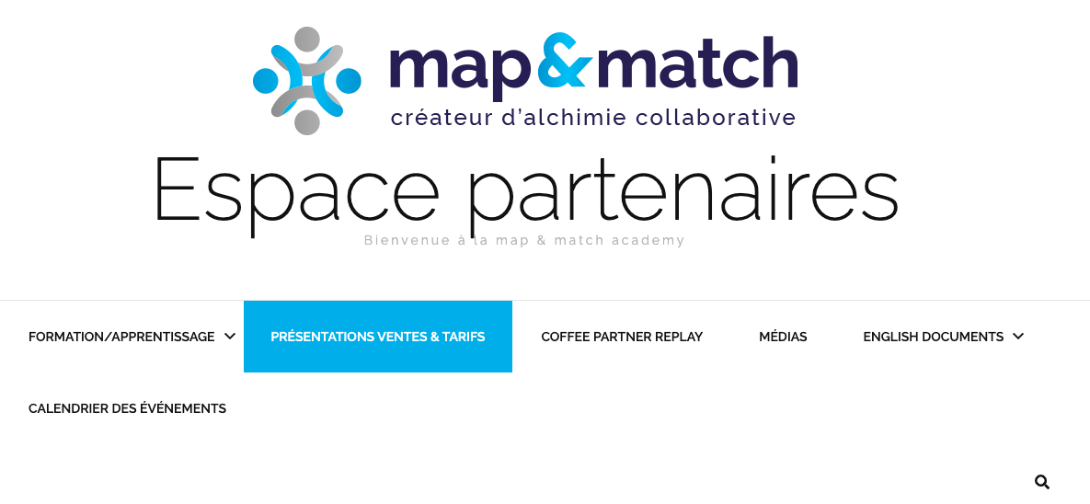
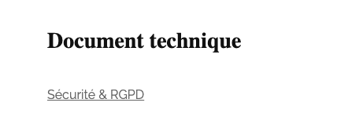
SECURITY AND GDPR
Security and cookies
Main principles:
  Data hosted by OVH in France
  Maintenance and security provided by map&match teams.
  Already audited by major groups such as Servier, BNP and Comdata.
GDPR document on the partner site in Technical Documents :
https://mapandmatch.partners/technical-documents/
Click here to see

Slide 10
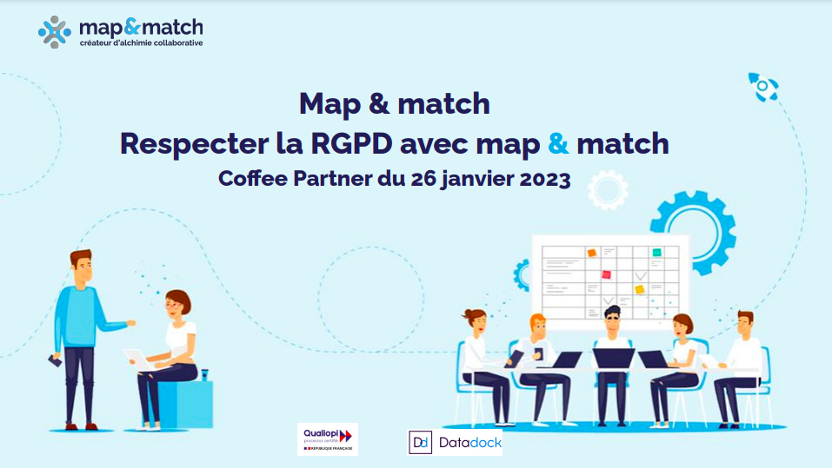
SECURITY AND GDPR
RGPD: Support coffee RGPD
Click here to see
Main principles:
The data controller is the customer, you, the partner, are the tier 1 S/processor, m&m is the tier 2 S/processor, OVH is the tier 3 S/processor.
The purpose of the processing is mandated by the mission and must be communicated to users.
Once carried out, there is no longer any reason in the GDPR sense to keep personal data. Unless there is a strong likelihood that it will be reused in a future assignment.
(Not specified by the CNIL, we recommend the same treatment as for recruitment, i.e. keep data for a maximum of two years, notifying the user)

Slide 11
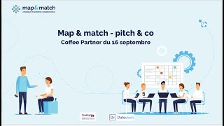
OPPOSITION MANAGEMENT
Tip: Topic covered from 25min onwards in the Coffee partner Replay on sales:

Slide 12


TABLE EXAMPLES OF VERBATIMS
"I already have the colors/DISC" | "The DISC tool is very good, as it works on relationships and understanding the other person. The map & match model doesn't work on behavioral patterns, but on complementarity. Being effective together for greater performance, in the work and not on behavior, that's the difference". → A good understanding in the dressing room is no guarantee of performance on the pitch
"I already have the MBTI” | "MBTI is a relevant tool but requires real specialization, whereas the T5 approach is easy to understand and accessible without being a specialist. An everyday tool" "Map & match is complementary and is part of an appetence logic and not a psychological preference, it answers the question "Why do I get up in the morning?"
"it's too early, I've just taken up my post". | "map & match will save you time in getting to know your team".
"I don't have HR to manage the map & match project". | "Map & match is not an HR solution but a performance management tool".
"I'm afraid of being judged" | "map & match is an objective tool, each profile has its place in the team, a tool that values the differences and complementarities brought by each person".

Slide 13
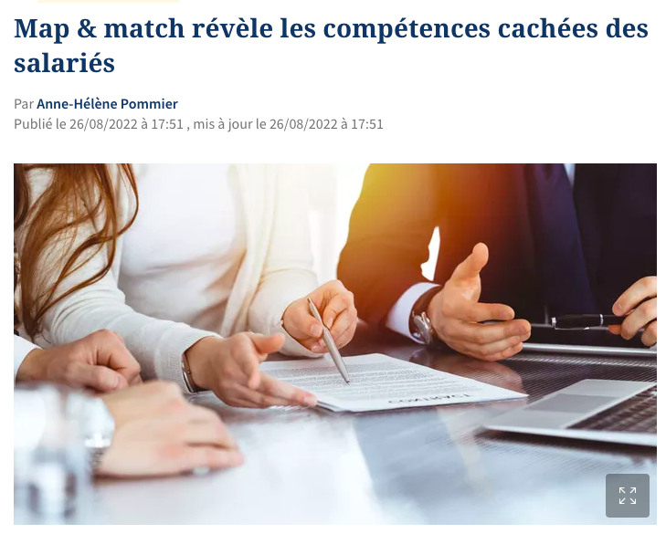
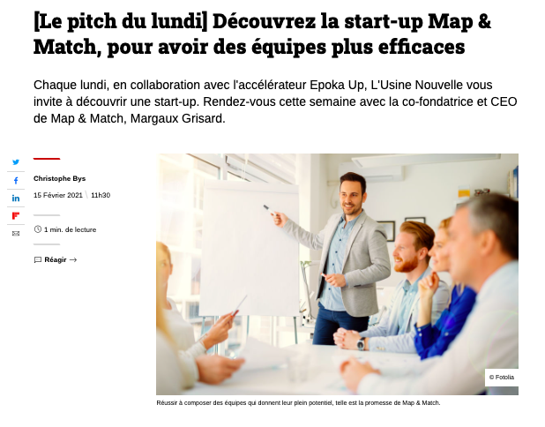
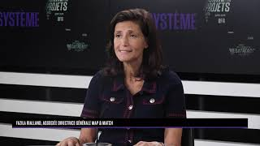
ANNEXES HELP/COMMUNICATION
Figaro article 👇
Usine Nouvelle article 👇

